Slide 1
The Blurse of Dimensionality
Dr Huw Day (he/him)
Huw.day@bristol.ac.uk
Blurse = Blessing + Curse

Slide 2
Questions I’m cursed to answer:
Can you code this for me in MATLAB/Excel/STATA?
Can I use AI to do ____?
Our ML model isn’t working very well, can’t we just give it more features?

Slide 3
“Visualising 9 dimensional space is easy: just visualise n-dimensional space and then let n=9.”
How do we visualize 9 dimensional space?
Notes:
The aim of this talk is for people who already appreciate the curse of dimensionality to maybe understand it better

Slide 4
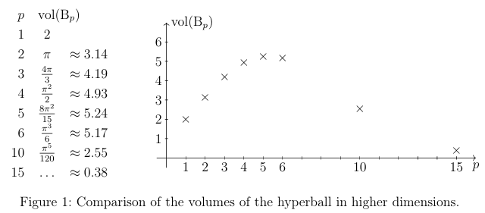
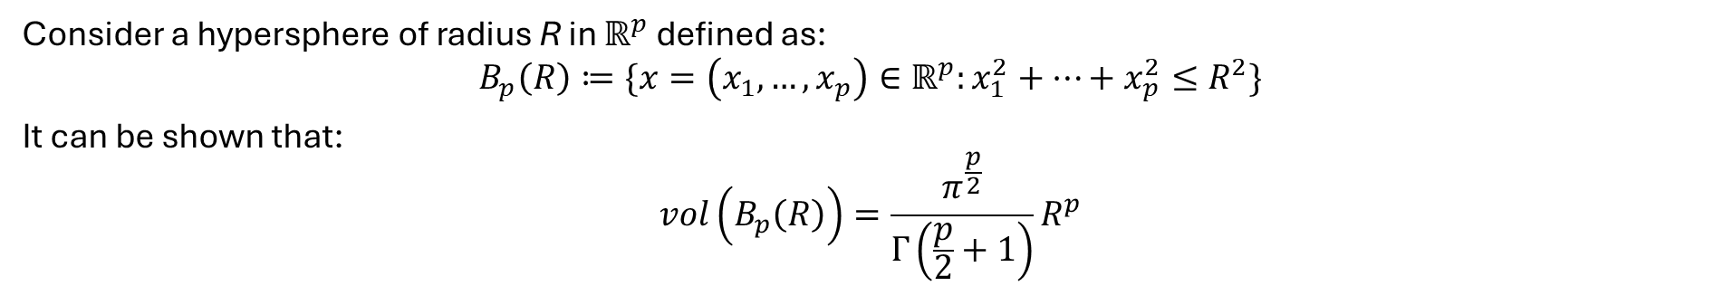
A rather excitable sphere
Consider a hypersphere of radius R in $ℝ^{p}$ defined as:
$$B_{p}\left(R\right)≔\{x=\left(x_{1}, …, x_{p}\right)∈ℝ^{p}:x_{1}^{2}+…+x_{p}^{2}≤R^{2}\}$$
It can be shown that:
$$vol\left(B_{p}\left(R\right)\right)=\frac{π^{\frac{p}{2}}}{Γ\left(\frac{p}{2}+1\right)}R^{p}$$
Figure from: https://rolandspeicher.com/wp-content/uploads/2023/08/hda_rmml.pdf
Notes:
We’re going to use ideas about a hypersphere in high dimensions of some radius to help us understand how vectors behave in large dimensions!

Slide 5
How can we think about high dimensional space?
In high dimensions:
The volume of a hypersphere is concentrated close to its surface
Any two vectors are likely to be almost orthogonal

Slide 6
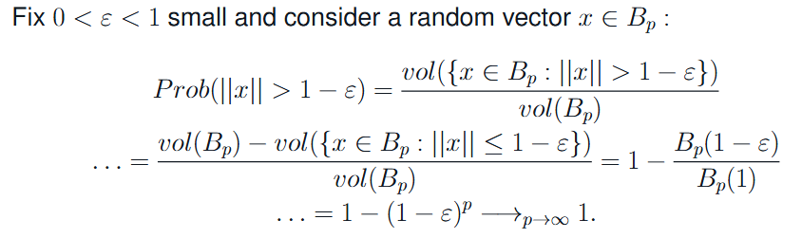

The volume of a hypersphere is concentrated close to its surface
“If you peel a high dimensional orange, not much is left”
$$vol\left(B_{p}\left(R\right)\right)=\frac{π^{\frac{p}{2}}}{Γ\left(\frac{p}{2}+1\right)}R^{p}$$
Notes:
Intuitively, the probability of the norm of a random vector inside the unit hyperball being epsilon far from the surface is just the ratio of the volume of the 1-epsilon hyperball divided by the volume of the unit hyperball
For fixed epsilon between 0 and 1, this probability grows to 1 as the dimension grows large.

Slide 7
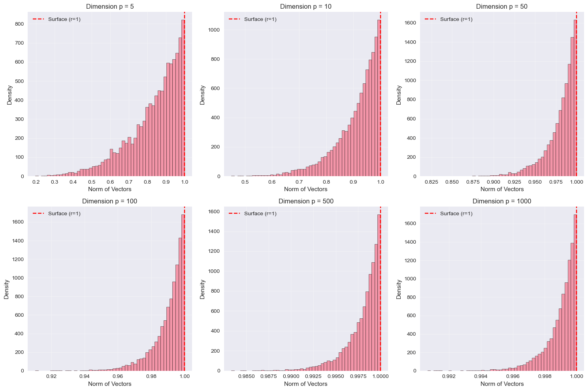

Slide 8
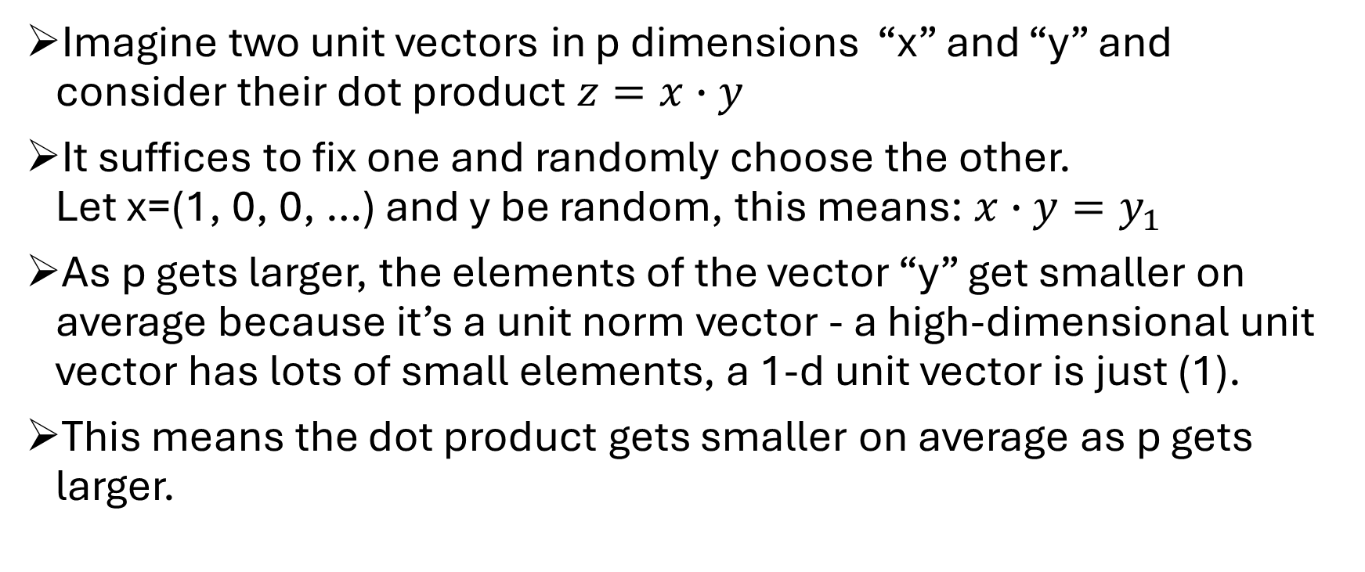
Any two vectors in the hypersphere are almost orthogonal (sketch proof)
Imagine two unit vectors in p dimensions “x” and “y” and consider their dot product $z=x∙y$
It suffices to fix one and randomly choose the other. Let x=(1, 0, 0, …) and y be random, this means: $x∙y=y_{1}$
As p gets larger, the elements of the vector “y” get smaller on average because it’s a unit norm vector - a high-dimensional unit vector has lots of small elements, a 1-d unit vector is just (1).
This means the dot product gets smaller on average as p gets larger.

Slide 9

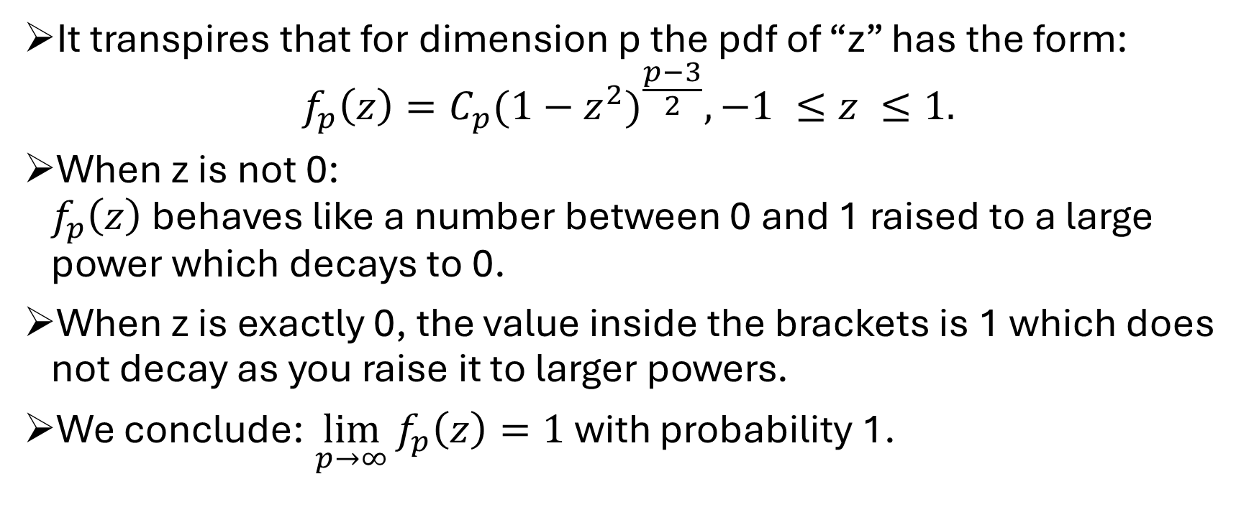
Any two vectors in the hypersphere are almost orthogonal (sketch proof)
$$C_{p}=\frac{Γ(\frac{p}{2})}{Γ(\frac{p−1}{2})\sqrt{π}}$$
It transpires that for dimension p the pdf of “z” has the form: $f_{p}\left(z\right)=C_{p}{(1−z^{2})}^{\frac{p−3}{2}}, −1 ≤z ≤1.$
When z is not 0: $f_{p}\left(z\right)$ behaves like a number between 0 and 1 raised to a large power which decays to 0.
When z is exactly 0, the value inside the brackets is 1 which does not decay as you raise it to larger powers.
We conclude: $\lim_{p→∞}{f_{p}\left(z\right)=1}$with probability 1.

Slide 10
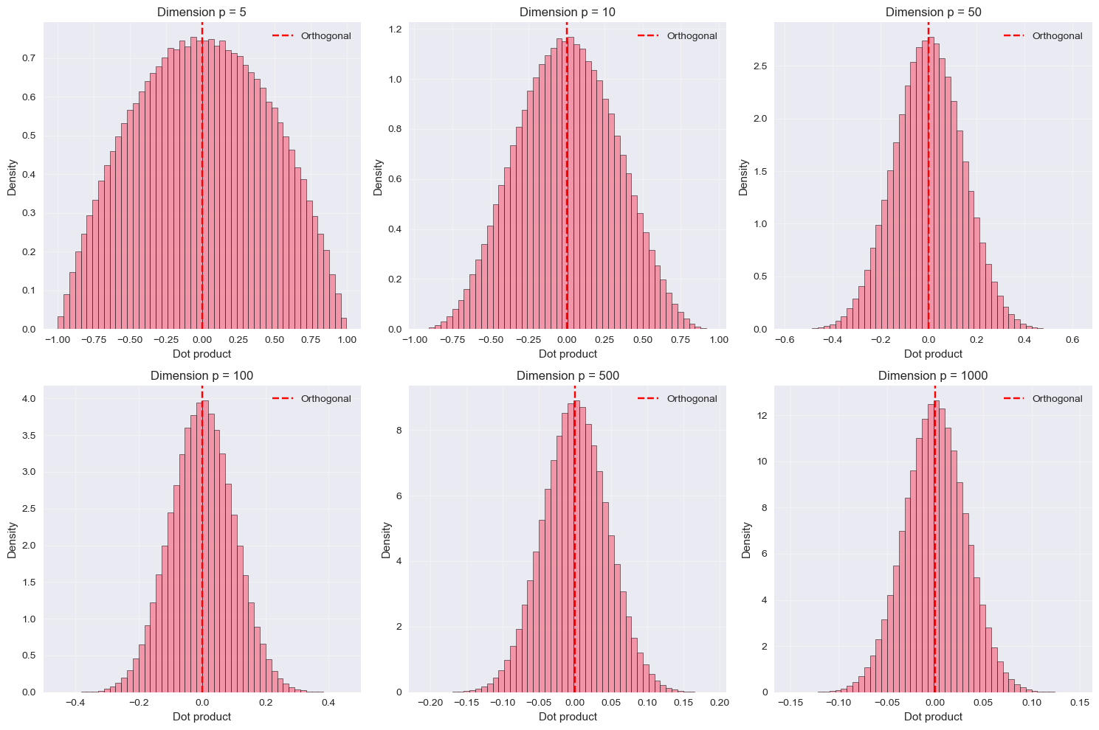

Slide 11
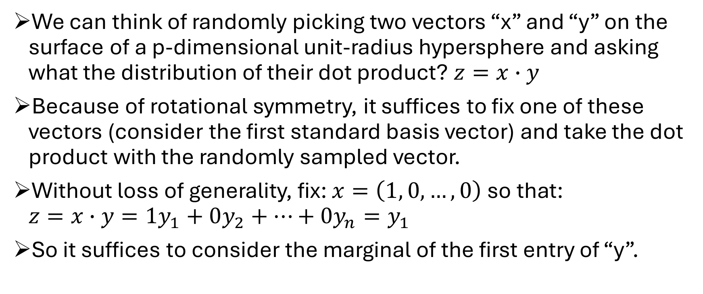
Any two vectors in the hypersphere are almost orthogonal (sketch proof)
We can think of randomly picking two vectors “x” and “y” on the surface of a p-dimensional unit-radius hypersphere and asking what the distribution of their dot product? $z=x∙y$
Because of rotational symmetry, it suffices to fix one of these vectors (consider the first standard basis vector) and take the dot product with the randomly sampled vector.
Without loss of generality, fix: $x=\left(1, 0, …, 0\right)$ so that: $z=x∙y=1y_{1}+0y_{2}+…+0y_{n}=y_{1}$
So it suffices to consider the marginal of the first entry of “y”.

Slide 12
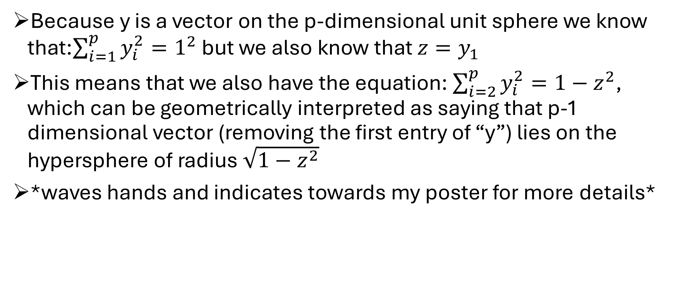
Any two vectors in the hypersphere are almost orthogonal (sketch proof)
Because y is a vector on the p-dimensional unit sphere we know that:$\sum_{i=1}^{p}{y_{i}^{2}=1^{2}}$ but we also know that $z=y_{1}$
This means that we also have the equation: $\sum_{i=2}^{p}{y_{i}^{2}=1−z^{2}}$, which can be geometrically interpreted as saying that p-1 dimensional vector (removing the first entry of “y”) lies on the hypersphere of radius $\sqrt{1−z^{2}}$
*waves hands and indicates towards my poster for more details*

Slide 13
Curse or Blessing?
Data gets sparse and it becomes increasingly difficult to sample the densities of distributions in high dimensions.
Many functions of random vectors and random matrices behave close to deterministically, making it much more routine to sample smooth, 1 dimensional functions of high dimensional vectors.

Slide 14
Acknowledgements/References
The content of this talk + poster is inspired by the notes and recordings of Roland Speicher's graduate course "High Dimensional Analysis: Random Matrices and Machine Learning" (https://rolandspeicher.com/lectures/course-on-high-dimensional-analysis-random-matrices-and-machine-learning-summer-term-2023/) [1].
Some of the figures were generated by Fahd Abdelazim from the Ask-JGI data science helpdesk (ask-jgi@bristol.ac.uk) code available on GitHub (https://github.com/HuwWDay/BlurseOfDimensionality) [2].

Slide 15
“The literature on machine learning is also in high dimension so you can get lost very easily but there can be some quite nice concentrations if you know where to look.” – Roland Speicher

Slide 16
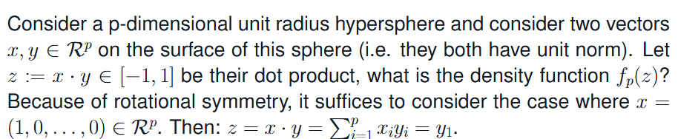
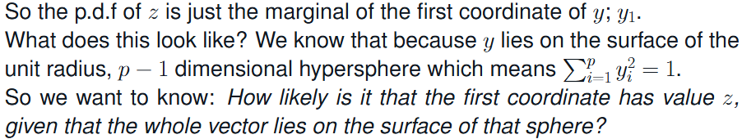
Any two vectors in the hypersphere are almost orthogonal

Slide 17
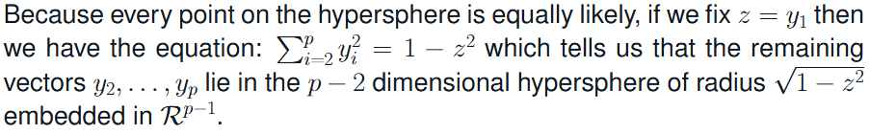
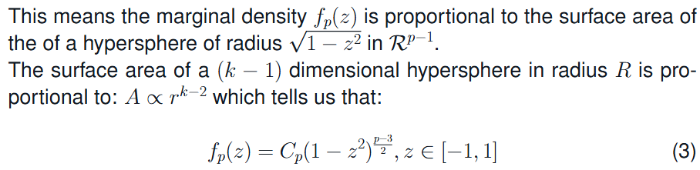
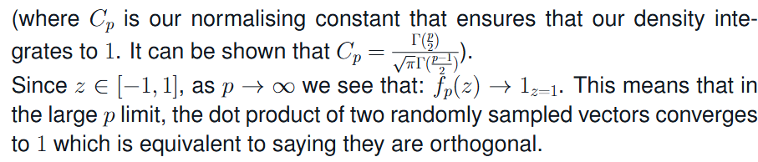

Slide 18
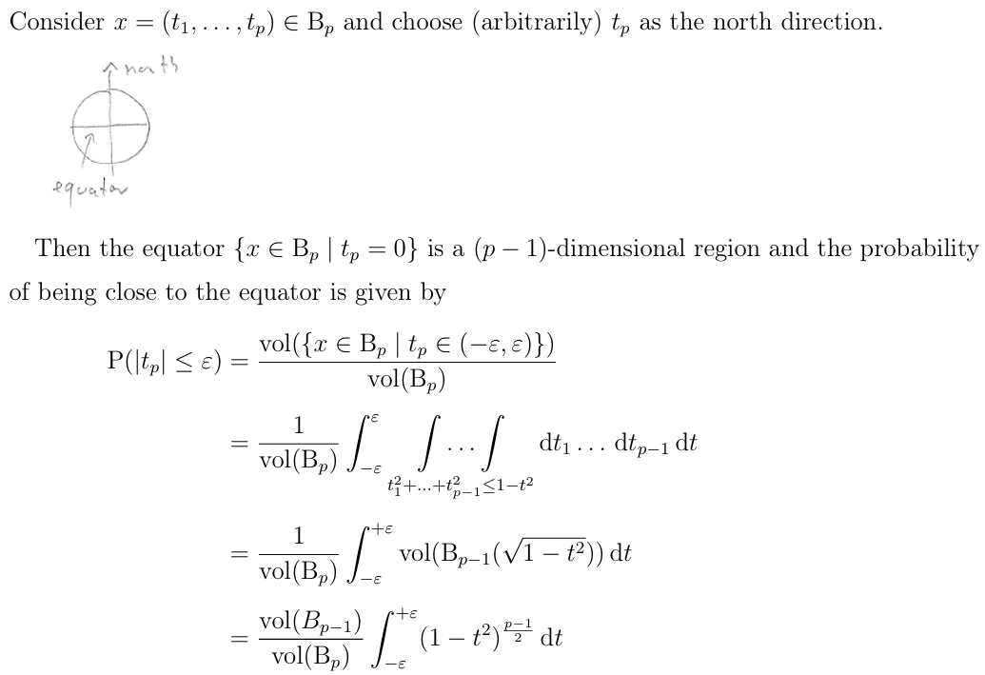
Almost all the volume of the hypersphere lies near its equator
Plot of probability of |t_{p}| less than epsilon for increasing values of epsilon
Integral approaches sqrt(2pi/ p) from above

